Slide 1
Object Oriented Design System Modeling
Part- 3

Slide 2
Topics covered
Context models
Interaction models
Structural models
Behavioral models

Slide 3
Structural models
Structural models of software display the organization of a system in terms of the components that make up that system and their relationships.
Structural models may be static models, which show the structure of the system design, or dynamic models, which show the organization of the system when it is executing.
You create structural models of a system when you are discussing and designing the system architecture.

Slide 4
Class diagrams
Class diagrams are used when developing an object-oriented system model to show the classes in a system and the associations between these classes.
An object class can be thought of as a general definition of one kind of system object.
An association is a link between classes that indicates that there is some relationship between these classes.
When you are developing models during the early stages of the software engineering process, objects represent something in the real world, such as a patient, a prescription, doctor, etc.

Slide 5
UML classes and association

Slide 6
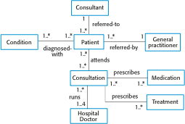
Classes and associations in the MHC-PMS

Slide 7

The Consultation class

Slide 8
Key points
A model is an abstract view of a system that ignores system details. Complementary system models can be developed to show the system’s context, interactions, structure and behavior.
Context models show how a system that is being modeled is positioned in an environment with other systems and processes.
Use case diagrams and sequence diagrams are used to describe the interactions between users and systems in the system being designed. Use cases describe interactions between a system and external actors; sequence diagrams add more information to these by showing interactions between system objects.
Structural models show the organization and architecture of a system. Class diagrams are used to define the static structure of classes in a system and their associations.

Slide 9
Generalization
Generalization is an everyday technique that we use to manage complexity.
Rather than learn the detailed characteristics of every entity that we experience, we place these entities in more general classes (animals, cars, houses, etc.) and learn the characteristics of these classes.
This allows us to infer that different members of these classes have some common characteristics e.g. squirrels and rats are rodents.

Slide 10
Generalization
In modeling systems, it is often useful to examine the classes in a system to see if there is scope for generalization. If changes are proposed, then you do not have to look at all classes in the system to see if they are affected by the change.
In object-oriented languages, such as Java, generalization is implemented using the class inheritance mechanisms built into the language.
In a generalization, the attributes and operations associated with higher-level classes are also associated with the lower-level classes.
The lower-level classes are subclasses inherit the attributes and operations from their superclasses. These lower-level classes then add more specific attributes and operations.

Slide 11
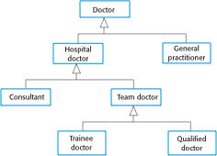
A generalization hierarchy

Slide 12
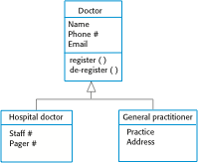
A generalization hierarchy with added detail

Slide 13
Object class aggregation models
An aggregation model shows how classes that are collections are composed of other classes.
Aggregation models are similar to the part-of relationship in semantic data models.

Slide 14

The aggregation association

Slide 15
Behavioral models
Behavioral models are models of the dynamic behavior of a system as it is executing. They show what happens or what is supposed to happen when a system responds to a stimulus from its environment.
You can think of these stimuli as being of two types:
Data Some data arrives that has to be processed by the system.
Events Some event happens that triggers system processing. Events may have associated data, although this is not always the case.

Slide 16
Data-driven modeling
Many business systems are data-processing systems that are primarily driven by data. They are controlled by the data input to the system, with relatively little external event processing.
Data-driven models show the sequence of actions involved in processing input data and generating an associated output.
They are particularly useful during the analysis of requirements as they can be used to show end-to-end processing in a system.

Slide 17
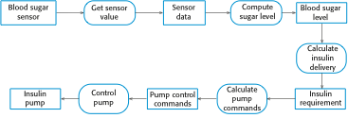
An activity model of the insulin pump’s operation

Slide 18
Event-driven modeling
Real-time systems are often event-driven, with minimal data processing. For example, a landline phone switching system responds to events such as ‘receiver off hook’ bygenerating a dial tone.
Event-driven modeling shows how a system responds to external and internal events.
It is based on the assumption that a system has a finite number of states and that events (stimuli) may cause a transition from one state to another.

Slide 19
State machine models
These model the behaviour of the system in response to external and internal events.
They show the system’s responses to stimuli so are often used for modelling real-time systems.
State machine models show system states as nodes and events as arcs between these nodes. When an event occurs, the system moves from one state to another.
Statecharts are an integral part of the UML and are used to represent state machine models.

Slide 20
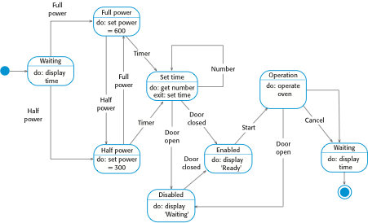
State diagram of a microwave oven

Slide 21
States and stimuli for the microwave oven (a)
State | Description
Waiting | The oven is waiting for input. The display shows the current time.
Half power | The oven power is set to 300 watts. The display shows ‘Half power’.
Full power | The oven power is set to 600 watts. The display shows ‘Full power’.
Set time | The cooking time is set to the user’s input value. The display shows the cooking time selected and is updated as the time is set.
Disabled | Oven operation is disabled for safety. Interior oven light is on. Display shows ‘Not ready’.
Enabled | Oven operation is enabled. Interior oven light is off. Display shows ‘Ready to cook’.
Operation | Oven in operation. Interior oven light is on. Display shows the timer countdown. On completion of cooking, the buzzer is sounded for five seconds. Oven light is on. Display shows ‘Cooking complete’ while buzzer is sounding.

Slide 22
States and stimuli for the microwave oven (b)
Stimulus | Description
Half power | The user has pressed the half-power button.
Full power | The user has pressed the full-power button.
Timer | The user has pressed one of the timer buttons.
Number | The user has pressed a numeric key.
Door open | The oven door switch is not closed.
Door closed | The oven door switch is closed.
Start | The user has pressed the Start button.
Cancel | The user has pressed the Cancel button.

Slide 23
Thank You!

